Slide 1
Solving Multi-Step Equations
September 9, 2017

Slide 2
IT’S FRIDAY

Slide 3
Binder Set-up
Section 1: Classroom Resources
Section 2: Daily Warmups
Section 3: Classwork
Section 4: Homework
Section 5: Tests/Quizzes

Slide 4
Reviewing the Do Now
The function below shows the cost of a hamburger with different number of toppings (t).
f(t) = 1.90 + 1.40t
What is the y-intercept (constant term) and what does it mean?
What is the slope (coefficient), and what does it mean?
If Jayden paid $7.50 for his hamburger, how many toppings were on Jayden’s hamburger?

Slide 5
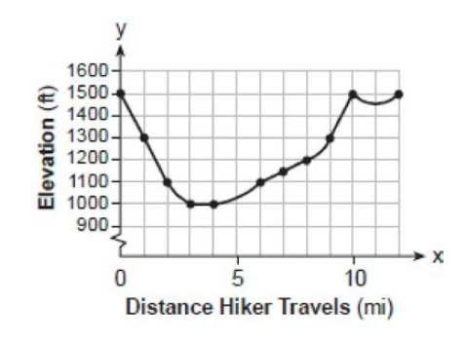
2) Identify the domain and range of the graph given.

Slide 6
Reviewing the Quiz

Slide 7
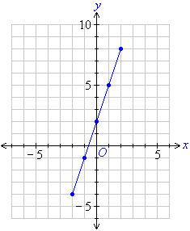
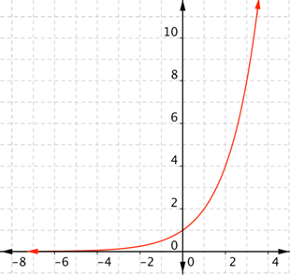
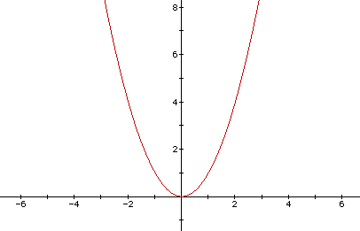
The Three Kinds of Functions & Their Graphs
Linear | Exponential | Quadratic
The highest power of x represented is 1 Example: f(x) = 4x-1 Graph is a straight line | The x is in the exponent Example: f(x) = 2^{x} Graph goes in one direction, curved | The highest power of x represented is 2 Example: f(x) = 2x²+2 Graph curves and changes direction

Slide 8
What kind of functions are represented by each of the following graphs?
Linear: Windmill arms
Quadratic: Opposite hand to opposite foot
Exponential: Pump your fist

Slide 9
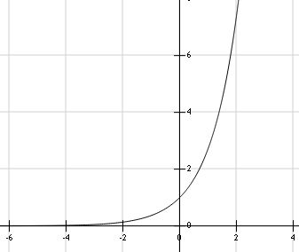

Slide 10
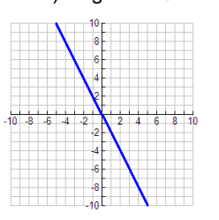

Slide 11
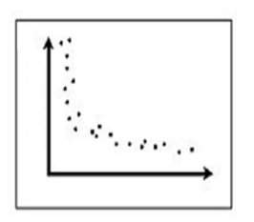

Slide 12
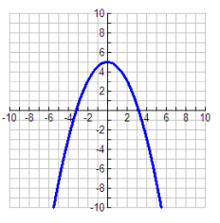

Slide 13
What types are each of the following functions?
f(x) = 4^{x} -3
f(x) = 7x² + 5x - 2
f(x) = -x + 3
f(x) = 9^{4x}

Slide 14
Inverse Operations
What is the inverse operation for….
Adding?
Multiplying?
Dividing?
Subtracting?

Slide 15
Solving multistep equations
5 + 14a = 32
3b + 2 = 11

Slide 17
4(2a + 3) = −3(a − 1) + 31

Slide 18
Antonio bought three bags of candy with 75 pieces in each one. He plans to divide all the candy evenly among seven friends. How many pieces of candy will Antonio have left for himself?

Slide 19
Anne earned $3 an hour baby-sitting, and $4 an hour working in the garden. Last week she did baby-sitting for 5 hours and garden work for 3 hours. How much more money does she need to buy a game that costs $35?

