Slide 1
Day 8
September 7, 2017

Slide 2
REMINDERS
TURN IN YOUR HOMEWORK TOMORROW THAT’S LITERALLY IT
Oh and also new tardy policy

Slide 3
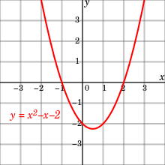
Reviewing the Do Now
Identify the y-intercept of the graph. What type of function is graphed?
“The graph is a _______________ function because
_________________________”

Slide 4
Reviewing the Do Now, Cont.
Marcus gets paid $280 per week plus 5% commission at Apple on all sales for selling electronic equipment. If he sells n dollars worth of Apple products in one week, write an expressions that represents the amount of money he will earn that week.
If Marcus earned $750 in the first week, what was the total amount of Apple products he sold that week?

Slide 5
Reviewing the Do Now, cont.
The population, f(x) of a small town (in thousands) after x years is represented by:
f(x) = 5(2)^{x}.
What type of function does the population represent?
What is the population after 2 years?

Slide 6
Ms. Sarro is given the expression:
f(x) = 3x²
She is told to evaluate f(-2).
She says it’s -12.
Is Ms. Sarro right or wrong? Prove it.

Slide 7
CUBES: with linear functions
Roger gets 40 per day as wages and $4.50 as commission for every pair of shoes he sells in a day. His daily earnings goal is $112.
Write an equation to determine how many pairs of shoes Roger must sell in a day to meet his daily earnings goal.
Find the number of pairs of shoes he must sell to meet his daily earnings goal.

Slide 8
Word Problems Practice

Slide 9
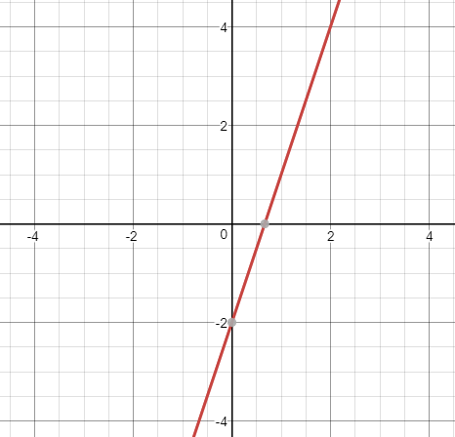
Multiple Representations of Functions
In this class we will look at 4 different ways to represent a function:
EQUATION f(x) = 3x - 2 | VERBAL (with words) The output of a function is two less than three times its input.
 | GRAPH
x | f(x)
-1 | -5
0 | -2
1 | 1
2 | 4

Slide 10
When might we want to use the different representations of each function?
Graphs? Easy to see
Tables? Find specific values
Words? To see what the function does
Equations?

Slide 11
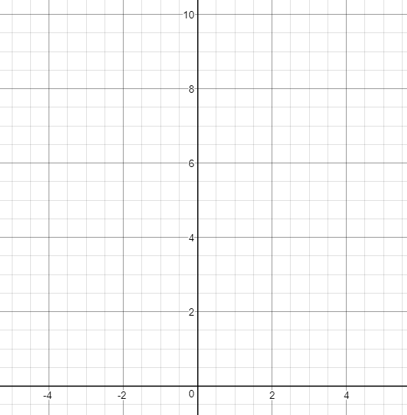
f(x) = x²+5
x | f(x)

Slide 12
QUIZ TIME

