Slide 1
Day 7
September 6, 2017

Slide 2
REMINDERS
We are setting up our binders on Friday. This means that you need to have a binder and dividers by Friday!!!!!
There is a quiz tomorrow. 5 questions, multiple choice- don’t stress.
Do your homework for Friday!!!!!

Slide 3
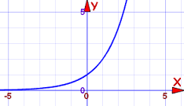
Reviewing the Do Now
Identify the y-intercept from the graph. What type of function is graphed?
The graph is a _______________ because __________________.

Slide 4
Reviewing the Do Now, Cont.
To watch a varsity basketball game, spectators must buy a ticket at the door. The cost of an adult ticket is $3.00 and the cost of a student ticket is $1.50. If the number of adult tickets sold is represented by a, and and student tickets sold by s, write an expression that represents the amount of money collected at the door from the ticket sales.

Slide 5
Reviewing the Do Now, Cont.
The function machine below, shows Michelle’s hourly wage. Suppose, Michelle works 12 hours (input). What are her wages?
If Michelle made $65.00 this week, how many hours did she work?

Slide 6
REVIEW: Simplifying Expressions
3w² -18(6w + 3) - 5w
How many terms are in the simplified version?
What is the sum of the coefficients in the simplified version?

Slide 7
How many terms are in the simplified version?
What is the sum of the coefficients in the simplified version?
18 + 8( -4 + 19c) + 2c
-q² -8( -11q + 5) + 17
4x² - 4(4 - 5x) +3

Slide 8
Three Kinds of Functions
Linear: The highest power that x is raised to is 1
Example: f(x) = ½x +2
Quadratic: The highest power that x is raised to is 2
Example: f(x) = x² - 5x
Exponential: The variable is in the exponent
Example: f(x) = 2^{x}

Slide 9
Examples
f(x) = 3^{x} +3
f(x) = 7x² + 5x - 2
f(x) = 9x + 3
f(x) = 4²^{x}

Slide 10
Parent Functions
The parent function of a family of functions is its simplest form.

Slide 11
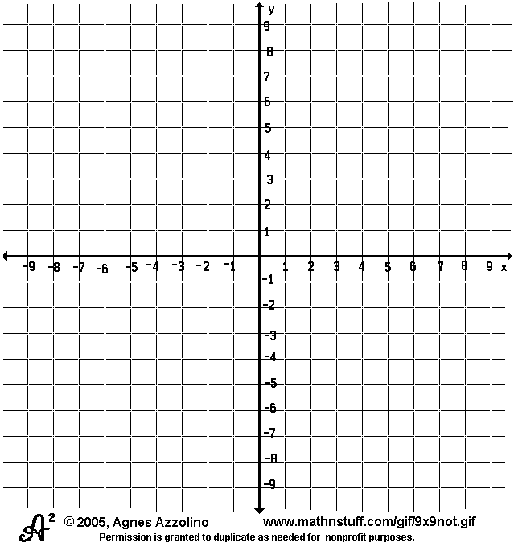
Graphs
The parent function of a linear function is
f(x) = x
What is the y-intercept of this graph? The slope?

Slide 12
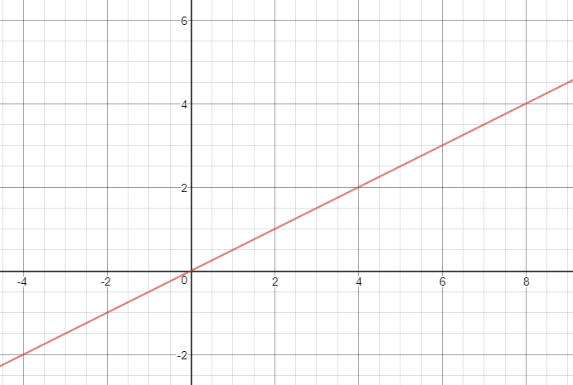
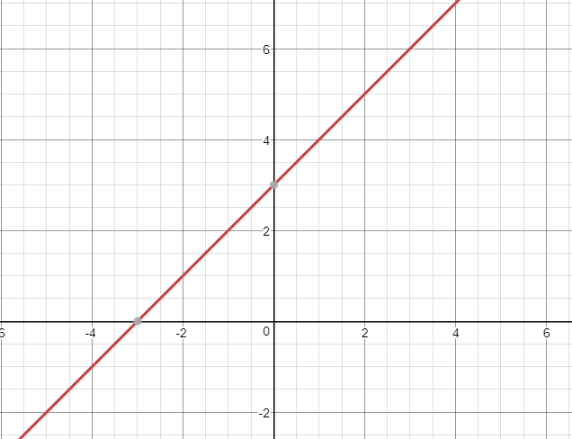
What happens if our slope changes? Our y-intercept?
f(x) = ½ x
f(x) = x + 3

Slide 13
Linear Word Problem Example
Glenna wants to rent a car for a trip to Key West for one week. She calls two car rental companies to get prices. Mr. Kotter’s Rentals rents a Cadillac Escalade for $99 for one week plus $0.11 per mile over 100 miles. Barbarino’s Rentals has the same vehicle for $75 per week and $0.15 per mile over 150 miles. If it is 432 miles to Key West, which company has the better deal? How many miles would Glenna drive before she would be spending the same amount at either company?

Slide 14
Quadratic Functions
The parent function of a quadratic function is
f(x) = x²
What is the y intercept of this graph?
What is the domain and range?

Slide 15
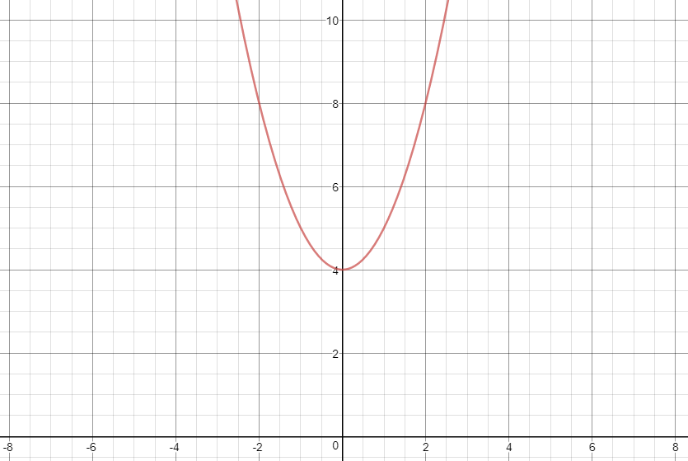
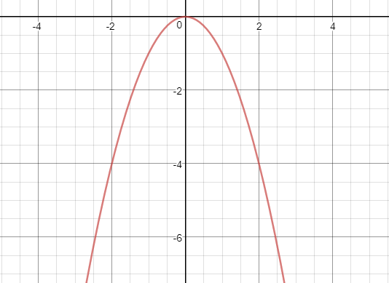
What happens if our y-intercept changes? Or if we make our x² negative?
f(x) = x² + 4
f(x) = -x²

Slide 16
Exponential Functions
The parent function of an exponential is f(x) = b^{x}. We are going to use 2 for b as our example. So, f(x) = 2^{x}

Slide 17
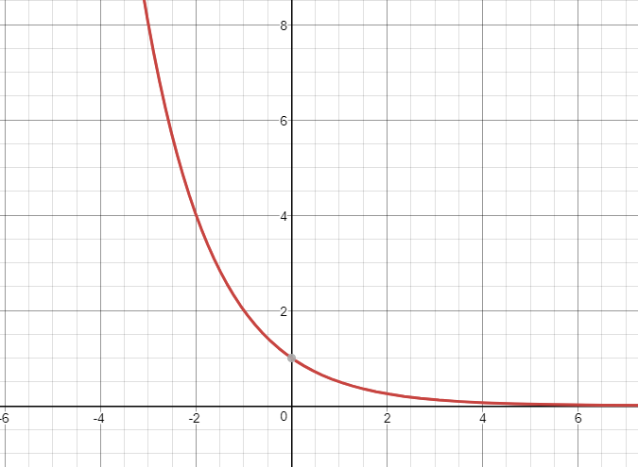
What if our b is a fraction?
f(x) = ½^{x}

Slide 18
A machine salesperson earns a base salary of $40,000 plus a commission of $300 for every machine he sells. Write an equation that shows the total amount of income the salesperson earns, if he sells x machines in a year

Slide 19
Conner has $25,000 in his bank account. Every month he spends $1,500. He does not add money to the account. a. Write a linear model that shows how much money will be in the account after x months. b. How much money will Conner have in his account after 8 months?

Slide 20
Max sells lemonade for $2 per cup and candy for $1.50 per bar. He earns $425 selling lemonade and candy.
a. Write a linear model that relates the number of cups of lemonade he sold to the number of bars of candy he sold.
b. If Max sold 90 bars of candy, how many cups of lemonade did he sell?

