Slide 1
Day 5
September 1, 2017

Slide 2
Do Now
Write your name (Escribe tu nombre) on your index card.
The height (in feet) (la altura) of a balloon (de un globo) filled with helium can be expressed by (puede ser expresada), 5 + 6.3𝑠, where s is the number of seconds since the balloon was released (s representa los segundos desde que fue lanzado). Identify (Identificar) the constant and coefficients of the expression.
A county fair charges $20 for an admission fee and $3.50 for each ride. Jose writes an expression to find the total amount he needs to pay for x number of rides. What does the constant term in the expression represent? (¿Que representa el constante en la expresión?)

Slide 3
IT’S FRIDAY YEAHHHHHHHHHHH

Slide 4
…. I PUT TWO SEPARATE SLIDES ABOUT HOW EXCITED I AM BECAUSE I AM VERY EXCITED

Slide 5
Reviewing the Do Now
The height (in feet) (la altura) of a balloon (de un globo) filled with helium can be expressed by (puede ser expresada), 5 + 6.3𝑠, where s is the number of seconds since the balloon was released (s representa los segundos desde que fue lanzado). Identify (Identificar) the constant and coefficients of the expression.
A county fair charges $20 for an admission fee and $3.50 for each ride. Jose writes an expression to find the total amount he needs to pay for x number of rides. What does the constant term in the expression represent? (¿Que representa el constante en la expresión?)

Slide 6
What is a function?
In your own words, what do we mean when we say function?

Slide 7
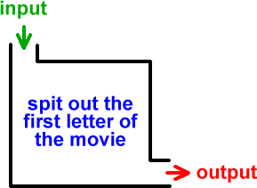
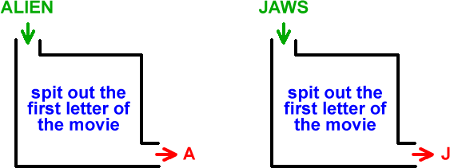

Slide 8
A Relation…..
We put in an input
We get out an output
When we say input: it also means x
When we say output: it also means y, or it can be referred to as f(x)

Slide 9
What makes a relation a function?
We say something is a function when, for every input, there is only one output.
Other ways that functions can be formatted:
(input, output)
f(x) =
Input | Output

Slide 10
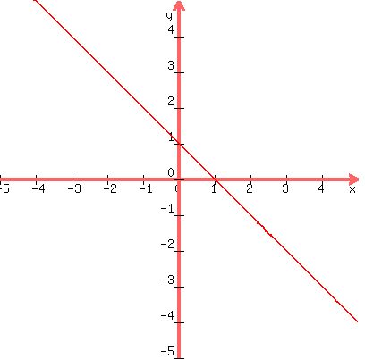
The Graph of a Function

Slide 11
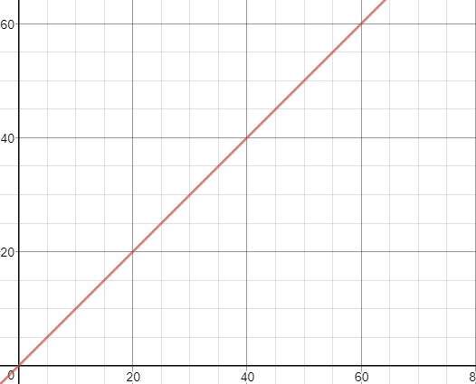
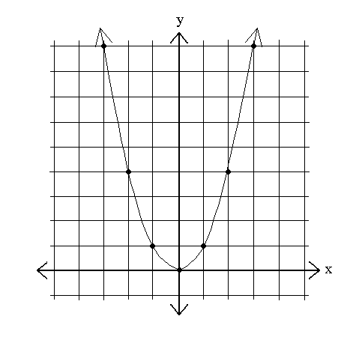
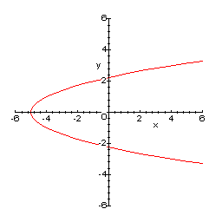
How do we know if a graph is a function?

Slide 12
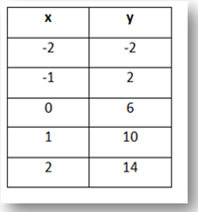
How do we know if table is a function?
X | Y
5 | 12
4 | 10
6 | 8
5 | 8
7 | 4
X | Y
0 | -3
2 | -3
-3 | -3
5 | -3
8 | -3

Slide 13
How do we know if a set of ordered pairs are a function?
{(3,5) (6,2) (5,8) (-3,9)}
{(7,12) (8,-3) (6,8) (7,11)}
{(7,0) (8,0) (6,0) (7,0)}

Slide 14
What are a function’s possible inputs? Possible outputs?
{(3,5) (6,2) (5,8) (-3,9)}

Slide 15
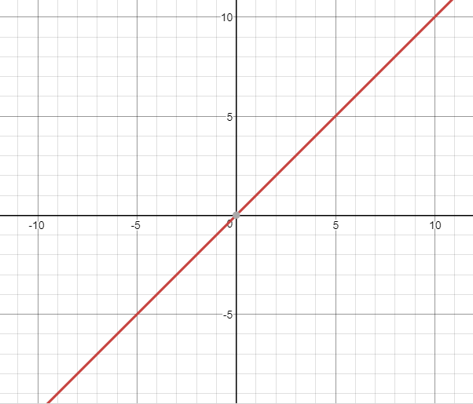

Slide 16
The set of all possible x-values is known as the domain.
The set of all possible y-values is known as the range.

Slide 17
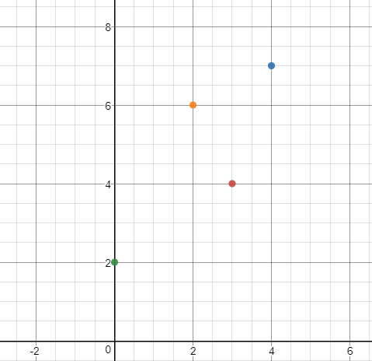

Slide 19
Evaluating functions from an equation
If f(x) is x+3, evaluate f(6).
Evaluate f(x) on the domain {2, 4, 6, 8}
What is the range of this function?

Slide 20
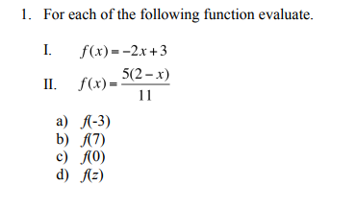

Slide 21
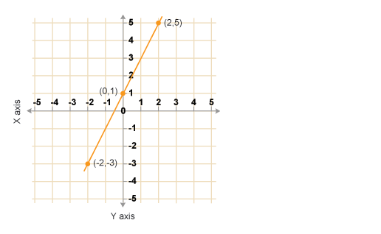
Evaluating functions from a graph
What is f(1)?

Slide 22
