Slide 1
Do Now
On a sheet of lined paper, write down 3 words that you associate with each of the following symbols. If you do not have a sheet of lined paper, take one from a friend. Escribe tres palabras asociadas con los símbolos abajo en una hoja.
+
-
*
÷

Slide 2
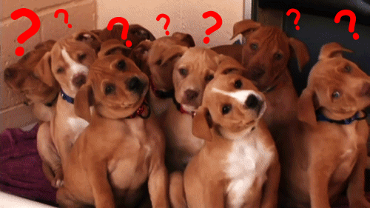
DID ANYONE BRING THEIR SYLLABUS?

Slide 3
The Words I thought of
+ | - | * | ÷
Add, increase, increase by, combined, sum, plus, total, in all, more than, addition | Subtraction, subtract, minus, take away, fewer than, decrease, decreased by, less, less than, deduct | Multiplication, multiply, times, double/triple/ twice, equal groups of, of, per, product | Division, divided by, separated into, percent, out of, quotient, equal group, shared equally, half, split

Slide 4
What is an expression?
An expression (expresion) is made up of multiple terms (términos), separated by one of the four symbols we just discussed.
An algebraic expression means that it has at least one variable, or one unknown (desconocido).
A term can be either a constant, a variable, or a product of a constant and a variable. If the term is a product, the constant in that product is known as a coefficient
What are some possible variables?
What are some possible terms?

Slide 5
Breaking it down
4x + 3

Slide 7
Do Now
Fill in your own definitions in the boxes provided underneath the words (e.g. coefficient, variable). In the boxes with the arrows, write what that part of the expression is called. What is 5x? What do we call that?
Escriban sus definiciones en las cajas debajo de las palabras. En las cajas con los flechas, escriban como se llama esa parte de la expresión. Por ejemplo, ¿como se llama el 5x? Pueden escribir en espanol.

Slide 8
Words -> Math
We can use words to write math expressions
The sum of y and 8
Thirty divided by seven times a number
X multiplied by 13
The quotient of C and 5

Slide 9
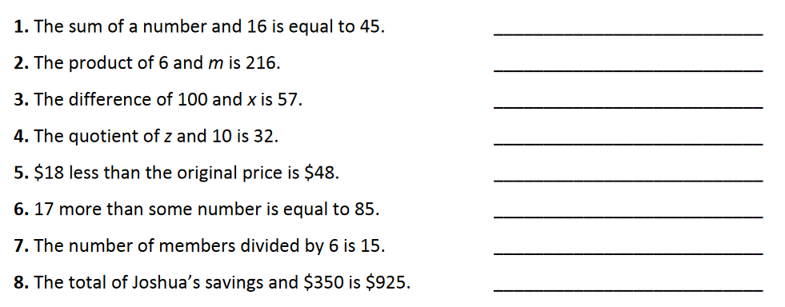

Slide 10
12 more than 6 of F
8 less than four times B

Slide 11
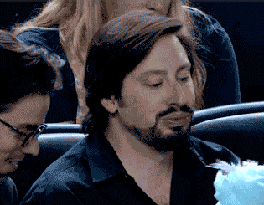
In reverse….

Slide 12
Word Problems using CUBES
The length of a rectangle is 3 feet less than 4 times its width. Write an expression for the length of the rectangle.
Train A travels 3 miles more than twice the distance that train B travels. Write an expression for the amount that train A travels.

Slide 13
Angela shared a cab with her friends. When they arrived at their destination, they evenly divided the $48 among the j of them. Angela also paid a $5 tip. Write an expression for the amount that Angela paid.
K friends evenly divided up a 12-slice pizza. One of the friends, Harris, ate 1 fewer slice than he was given. Write an expression for the amount that Harris ate.

Slide 14
In your own words….
What is a function (una función)?

Slide 15
Is this machine functioning? (¿Esta máquina está funcionando?)
Input Output
Coke Button --> Coke Can
Coke Button --> Coke Can
Sprite Button --> Sprite Can
Coke Button --> Coke Can

Slide 16
Input Output
Coke Button --> Coke Can
Coke Button --> Sprite Can
Sprite Button --> Root Beer Can
Coke Button --> Water Bottle

Slide 17
In order for something to be a function….
Each input has to have only one output

Slide 18
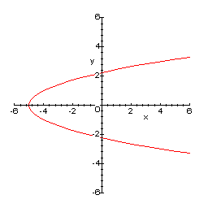
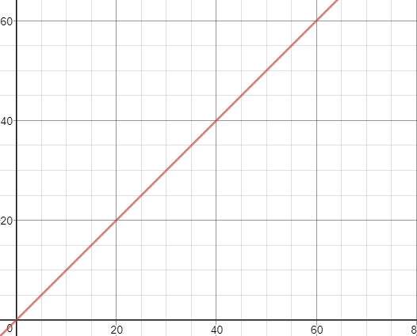
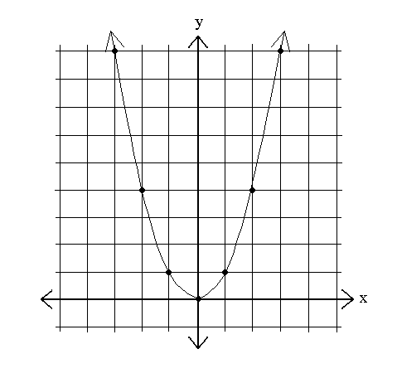
How do we know if a graph is a function?

Slide 19
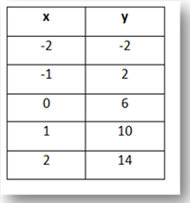
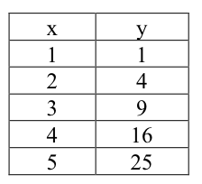
How do we know if a table is a function?

Slide 20
How do we know if ordered pairs are functions?
{(3,5) (6,2) (5,8) (-3,9)}
{(6,5) (8,20) (7,5) (6,-4)}
{(4,5) (3,5) (6,5) (-3,5)}

Slide 21
Can we put any x-value that we want into a function?
{(3,5) (6,2) (5,8) (-3,9)}

