Slide 1
Arithmetic Sequences, cont. & More Review
September 17, 2017

Slide 2
YOUR TEST IS TOMORROW STUDY!!!!!

Slide 3
Refresher on Arithmetic Sequences
A. –4, –2, 0, 2, …
B. –8, –4, –2, –1, …
C. –4, –3, –1, 2, …
D. –4, 0, –4, 0, …
Which of these four sequences is arithmetic? How do you know? What is the common difference? How did you find it?

Slide 4
When we left off….
We were asking how we might find the 100th term of a sequence.
We don’t want to just count up, that would take forever. We need to look for a formula.
There are two types of formulas: recursive and explicit.

Slide 5
Recursive Formulas
A recursive formula tells us how to get to the next term from the previous one. We format it like this:
a_{n}=a_{n-1}+ d
Where….
a_{n} is the term we are looking for, a_{n-1} is our previous term, and d is our common difference.

Slide 6
For example:
In the sequence:
4, 7, 10, 13,..... the recursive formula is a_{n}=a_{n-1}+ 3
There is something missing from this formula, however!
What is the difference between these two sequences?
4, 7, 10, 13,..... 2, 5, 8, 11,.....

Slide 7
You Do: Write recursive formulas for the following sequences. Make sure you define your a_{1.}
9,−1,−11,−21
14,30,46,62,...
13,6,−1,−8,...
4,22,40,58,.....

Slide 8
Just finding recursive formulas is not enough!
We still need a way of being able to find the later terms
Given the arithmetic sequence 3, 7, 11, 15 ….. What is the 50th term?

Slide 9
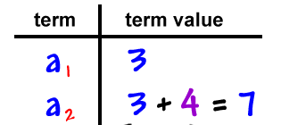
Make a Table!

Slide 10
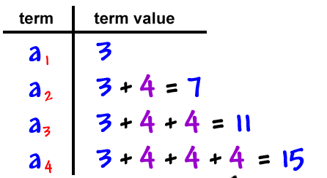
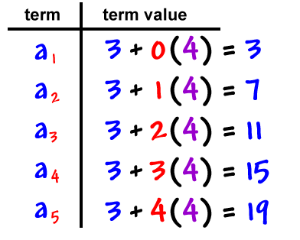
How can we condense these?

Slide 11
Explicit Formulas
Explicit formulas allow us to find any term without knowing the one before it!
We write it as:
a_{n} = a₁ + d(n-1)

Slide 12
For Example:
7, 10, 13, 16,... Recursive formula: a_{n} = a_{n-1} + 3, a₁ = 7
Explicit formula: a_{n} = 7 + 3(n-1)
75, 87, 99, … Recursive formula: a_{n} = a_{n-1} + 12, a₁=75
Explicit formula: a_{n} = 75 + 12(n-1)
27, 21, 15, 9, 3, Recursive formula: a_{n} = a_{n-1} + ??, a₁ = ???
Explicit formula: a_{n} = ?? -??(n-1)

Slide 13
You Try!
15, 13, 11, 9,.....
5/2, 3/2, ½, -½…..
3, 11, 19, 27, 35…..
Find the explicit and recursive formulas, as well as the 20th term in each of these sequences.

Slide 14
Sum of an arithmetic sequence
We can find what all the numbers in an arithmetic sequence add to by using an equation:

