Slide 1
Review Day 2
September 14, 2017

Slide 2
Do Now
A county fair charges $8 for an admission fee and $3 for each ride to create a total cost.
Write an equation that represents this function. What is the y-intercept of this equation? What is the slope?
If Franklin pays $35 in total at the fair, how many rides did he go on?

Slide 3
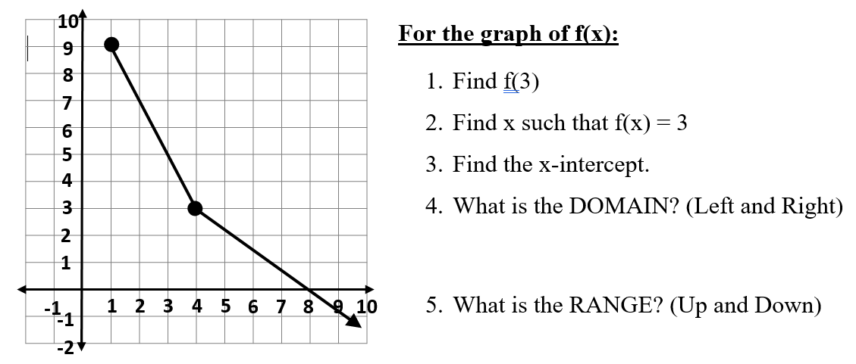
Finding the Domain and Range from Graphs

Slide 4
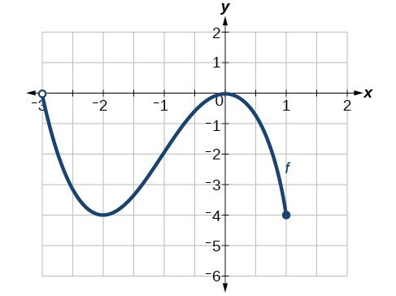

Slide 5
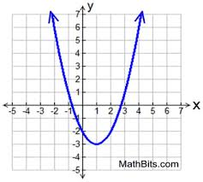

Slide 6
SIMPLIFY THIS EXPRESSION. What is the SUM OF THE COEFFICIENTS?
-4x²+8x-2(x-3) -6

Slide 7
What are the term(s), coefficient(s), and constant described by the phrase, “the cost of 5 tickets to the football game, t, and a service charge of $13”?

Slide 8
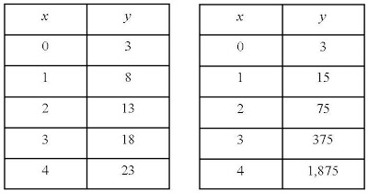
How to tell if a table is LINEAR or EXPONENTIAL

Slide 9
Pine Bluff Middle School is having its annual Spring Fling dance, which will cost $400. The student treasurer reported that the dance fund has $75 left over from last year. Each ticket to the dance costs $4.
Let t represent the number of tickets sold. Write an inequality to determine how many tickets must be sold to pay for this year's dance.

Slide 10
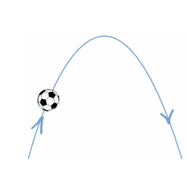
SOCCER BALLS move in QUADRATICS

Slide 11
Collin noticed that various combinations of nickels and dimes could add up to $0. 55.
Let x equal the number of nickels.
Let y equal the number of dimes.
What is the domain where y is a function of x and the total value is $0.55?

