Slide 1
First Review Day
September 13, 2017

Slide 2
On a sheet of notebook paper, solve the following Three problems. You must work independently.
8x - 40 = 4x - 12 −3(1 + 6r) = 14 − r
2) Jesus has a $30 gift certificate for a movie theater. Each time that he sees a movie, m, $7.50 is deducted from his gift certificate balance, b..
Write an equation to describe the relationship in terms of m and b.
Which value is the dependent quantity (your y-value/output) in this functional relationship?
Which value is the independent quantity (your x-value/input) this functional relationship?

Slide 3
Reviewing the do now
8x - 40 = 4x - 12 −3(1 + 6r) = 14 − r

Slide 4
Angie’s softball team is playing in the championship game. They are losing by a score of 17 to 6. There are 4 innings to go. Kim wants to know how many runs her team needs per inning to win the game if the other team does not score. (Each run is worth 1 point.)
Let r represent the number of runs per inning. Assume that the team scores the same number of runs per inning, and write an inequality to determine the number of runs per inning needed to win the game.

Slide 5
Monica noticed that various combinations of $1 and $5 bills could make $37. Let x represent your number of $5 bills and y represent your number of $1 bills.
What is the domain and range of your this function where y is a function of x and the total value is $37?

Slide 6
Collin noticed that various combinations of nickels and dimes could add up to $0. 55.
Let x equal the number of nickels.
Let y equal the number of dimes.
What is the domain where y is a function of x and the total value is $0.55?

Slide 7
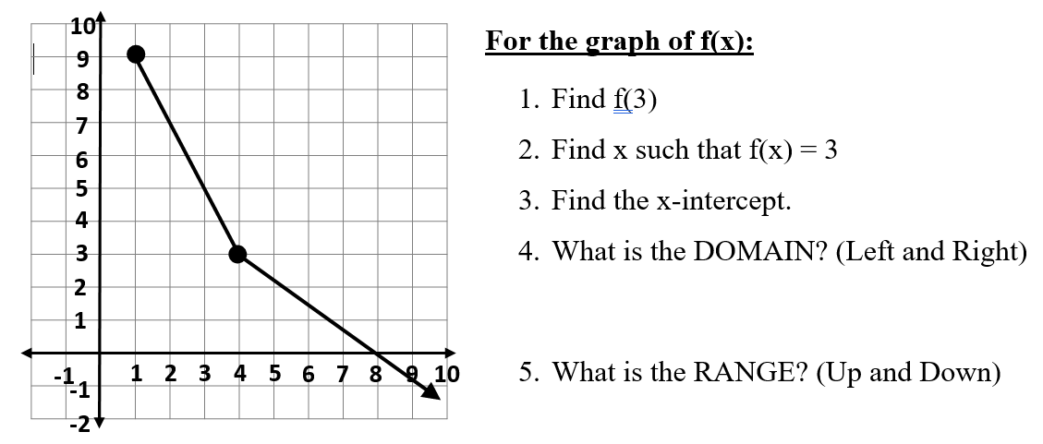

Slide 8
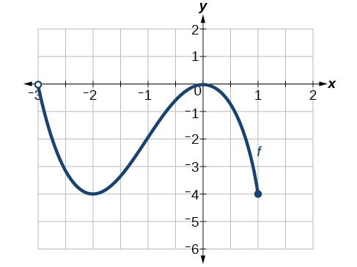

Slide 9
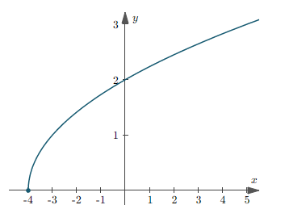
Domain & Range?

