Slide 1
Literal Equations & Other Kinds of Equations
September 12, 2017

Slide 2
Reviewing the Do Now

Slide 3
What is a literal equation?
What do you think of when you hear the word “literal”?

Slide 4
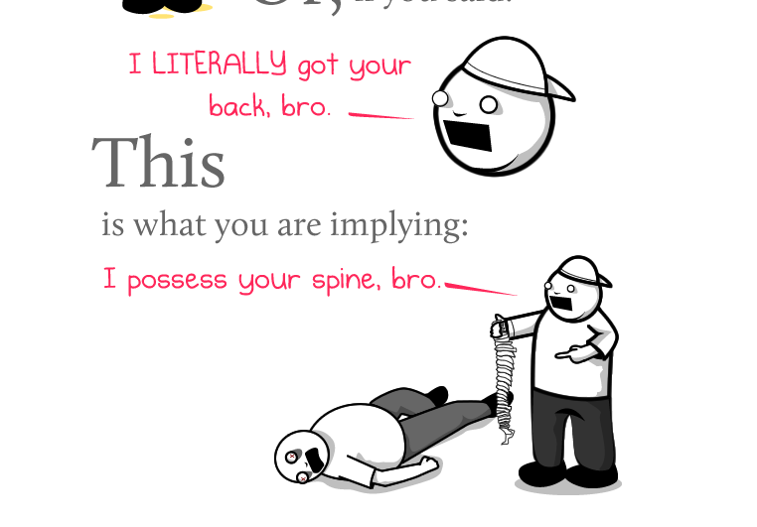
Literal = actually, really, without exaggeration…..

Slide 5
Literal Equations
Literal equations contain more than one variable. To solve it, you isolate the variable- BUT, your answer will still have a variable in it.
Tenemos que aislar la variable
Examples: 2x = 10 gh = m (solve for g)

Slide 6
The steps we take are the same.
2x + 5 = 11 ax + b = c

Slide 7
ab + cd = g
Solve for a, then solve for c.

Slide 8
What is the first step to solve….
3x - 6y = 17 for x?
Add 3x
Subtract 3x
Add 6y
Subtract 6y

Slide 9
What is the first step to solve….
3x - 6y = 17 for y?
Add 3x
Subtract 3x
Add 6y
Subtract 6y

Slide 10
You Do, Alone
P = 2(l + w), for l | 5t - 2r = 25, for t
T = m - n, for n | V = lwh, for w
H = vt + 16t², for v | xm = x+z, for x

Slide 11
Word Problems
The formula for distance is given by:
D = rt.
What is the formula for r, using our knowledge of literal equations?

Slide 12
Using the equation we just got for r…..
How fast do you need to be going to travel 500 miles in 8 hours?

Slide 13
Domain
Mariah noticed that various combinations of $1 and $5 bills could make $28. Let x represent the number of $1 bills and y represent the number of $5 bills. What is the domain where y is a function of x and the total amount is $28?
X
Y

Slide 14
8x²+4=76

Slide 15
Domain and Range of Graphs

